Slide 1

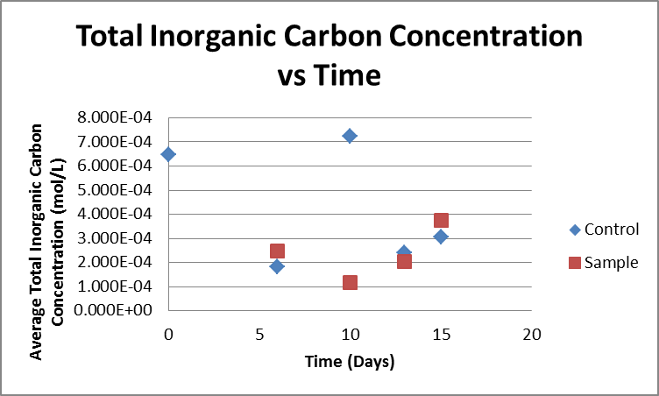
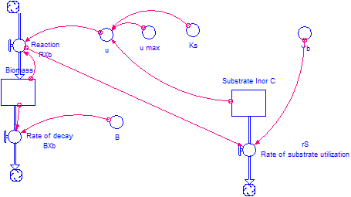
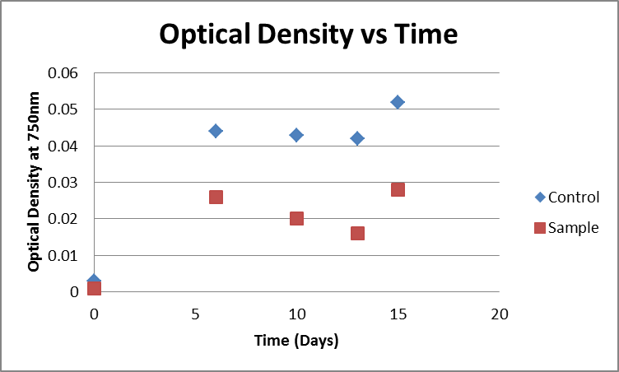
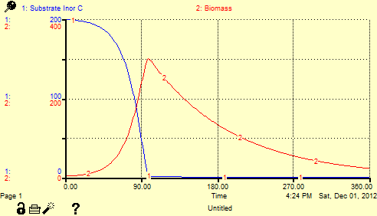
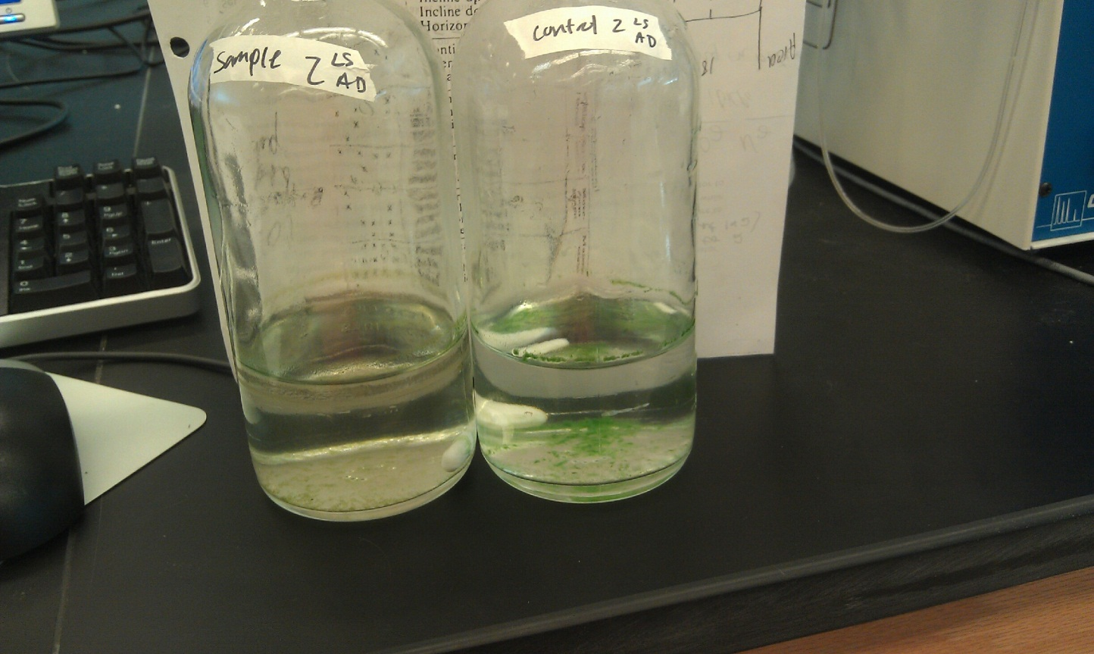

Algal Production of Hydrogen using Sodium Sulfite as an Oxygen Inhibitor
Allison DeNunzio, Lindsey Smith, Caye Drapcho
Biological Kinetics, Biosystems Engineering, Clemson University, Clemson, SC 29630
Abstract
Results
Model Development
The objective of this research experiment was to produce hydrogen gas from an algal growth using sodium sulfite as an oxygen inhibitor and electron source. This experiment shows that hydrogen production from algae is indeed possible. Sample 3 at 13 days produced an average hydrogen gas concentration of 0.31%. Further research is necessary in order to optimize this process.
Introduction
With the recent push for renewable energy, algae is becoming a source of much research and development. Much of this research is focused on the production of hydrogen gas for use in fuels and clean energy. In order to produce hydrogen gas from an algal growth, oxygen production must be inhibited. A sulfur source can be used to do this during photosynthesis. When sulfur is used as an electron source in an algal growth, sulfur is split from its compound by light energy and the sulfur ion will bond to oxygen produced at the end of photosynthesis. The equation demonstrating this process using sodium sulfite as a sulfur source is shown below:
$$2{Na}_{2}{SO}_{3}+O_{2}→2{Na}_{2}{SO}_{4}+2e^{−}$$
$$2e^{−}+\frac{1}{2}O_{2}→H_{2}O$$
The objective of this experiment was to produce hydrogen gas from an algal growth by using sodium sulfite as an oxygen inhibitor.
Where the specific growth rate constant (u=(u max*S)/(S+Ks)), the maximum specific growth (u max) for freshwater algae is 0.0726 hr⁻¹, the half-saturation constant (Ks) is 17.42 mg/L, the biomass yield (Yb) is 1.84896 mg Xb/mg S, and the decay constant (B) is .01 hr⁻¹. The initial biomass concentration (Xb) was 2 mg/L and the initial substrate concentration (S) was 200 mg/L.
Figure 1: Graph of total inorganic carbon concentration versus time for both the controls and the samples
Table 1: Percent gas concentration data for each sample and control
Materials and Methods
Table 2: OD and theoretical TSS data for each sample and control. OD values are used for construction of Figure 2
Figure 2: Graph of optical density versus time for both the controls and the samples
Serum bottles
Stir plates
Light source
BG11- algal growth medium
pH meter
Gas Chromatographer
Pressure Sensor
Spectrophotometer (Spec20)
As expected from intuition and previous knowledge in this process, as the biomass concentration increases, the substrate decreases. Once the substrate reaches zero, there is no more carbon remaining for the algae to utilize. At this point the biomass concentration begins to steadily decline.
Conclusions
The optimal time period for the production of hydrogen gas in an algal growth with sodium sulfite as a sulfur source is about 13 days. Sample 3 produced an average of 0.31% hydrogen gas.
Adding sodium sulfite to the algae seemed to slightly inhibit its growth. An alternative means of performing a similar experiment would be to add cysteine in place of the sodium sulfite to avoid the hindrance of growth.
Nitrogen gas production increases with time.
First, eight serum bottles were obtained and 150 mL of BG11 algal growth medium and 10 mL of freshwater algae inoculum was deposited in each. Four of these serum bottle then received 0.3672 g of sodium sulfite, Na₂SO₃. The amount of sodium sulfite added was determined based on the chemical oxygen demand, COD, of algae. The bottles containing sodium sulfite were referred to as the “Sample” bottles, while the bottles containing just algal medium were referred to as “Control” bottles. Each Sample and Control bottle obtained a number 1-4 referring to when the bottles would be sampled. Because the component of interest in this experiment was gas content, once a bottle was sampled and tested, it was discarded. The first testing for both Control 1 and Sample 1 was performed six days after inoculation. The second sample was tested four days following that, the third sample was tested three days following the second sample and the final sample was taken two days following the third sample. The experiment was run for 15 days total. For each sampling, the gas produced was tested using the gas chromatograph, the optical density was taken using a spectrophotometer and alkalinity was determined using titration and was then used to calculate total inorganic carbon concentration. The final sample was used to create a Total Suspended Solids calibration curve.
Table 3: Total Suspended Solids, TSS, data for each sample
Figure 1 shows the total inorganic carbon concentration for each sample. The graph was constructed using the alkalinity values obtained at each sampling. The graph should have a general decreasing trend because carbon should be consumed by the algae as it is growing. Figure 2 shows the optical density, OD, of each sample and control versus time. The general trend of this graph should be increasing throughout the experiment because the algae was growing and becoming more dense. However, taking the OD of algae is quite difficult because the algae flocculates and falls out of solution. The OD values do show that the control had a higher concentration of algae. Table 3 shows the data for total suspended solids, or TSS. This table shows that the sample had a higher concentration of algae than the control, which was not shown by the OD values in Table 2 or observation throughout the experiment. Table 2 shows the OD values obtained, and the corresponding theoretical TSS values based on a calibration curve constructed previously in lab. Because the OD values were very scattered, the corresponding TSS values are also scattered. As with OD, the TSS values should have increased throughout the experiment. The theoretical TSS values are very different from the actual TSS values obtained during the last sampling. This could be because of the calibration curve used or because the OD values were not very consistent. Finally, Table 1 shows the percentage of nitrogen and hydrogen gas in each sample. The only time hydrogen gas was shown was in the third sampling at 13 days. The remainder of the samples only showed nitrogen gas production.
References
1. Drapcho, Caye M., Nghiem Phu Nhuan, and Terry H. Walker. Biofuels Engineering Process Technology. New York: McGraw-Hill, 2008. Print.
2. Drapcho, 2012. “Lecture 10: Lithotrophic Growth.” BE 410 Lecture Handout. Clemson University, SC.
3. Drapcho, 2012. “Lab 5: Methods of Biomass Determination: Optical Density (OD) and Biomass Dry Weight (Total Suspended Solids).” BE 410 Laboratory Handout. Clemson University, SC.
4. Drapcho, 2012. “Lab 3: Analytical Determination of pH, Alkalinity, and Total Inorganic Carbon.” BE 410 Laboratory Handout. Clemson University, SC.
5. APHA. 1995. Standard Methods for the Examination of Water and Wastewater, 19th Edition. American Public Health Association, Washington, DC.
Acknowledgements
Dr. Caye Drapcho
Biosystems Engineering lab, CU
Archana

