Slide 1

Heat Exchanger Design for the Partition Aquaculture System
Lindsey Smith
Allison DeNunzio
Amanda Chura

Slide 2
Objectives
Use heat transfer equations to design a heat exchanger to cool the PAS
Implement and test design on a smaller scale
Make conclusions from data collected

Slide 3
The Problem
Algae need to be maintained at an optimal temperature for growth (25°C)
In the summer in South Carolina, water temperature is about 32°C
Need to cool system to keep temperature at appropriate level

Slide 4
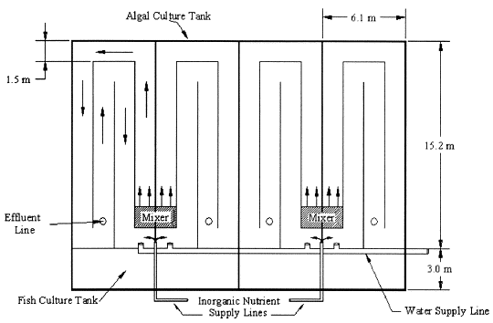
The Steps
System Boundary: PAS
Energy movement: convection, radiation
Thermal energy generation: none
Time frame: 8 hours
Steady state or transient? Steady state

Slide 5
Methods- Pre-Design Calculations
The h value for the inflow and outflow of the pipe were calculated using assumed temperature values
The convection due to the wind outside and the heat from radiation were also calculated
A spreadsheet was developed to calculate the parameters of the pipe necessary to get the desired convection of the pipe to satisfy the thermal energy balance

Slide 6
Methods and Materials- Design Process
A lab scale version of the aquaculture was created by filling a 5’x5’ tub with water, microalgae, and nutrients
Due to our calculations we used the most abundant source of tubing available for our heat exchanger, over 30’ of vinyl tubing (with 26’3” of tubing in the tub) with a diameter of 1/2” and a thickness of 1/16”
Tub was constantly filled with cool water from a hose to serve as a source for the inflow to our heat exhanger
Two peristaltatic pumps were connected to the piping to keep the aquaculture mixed and to pump the cool water from the inflow tub at a maximum flowrate of 1558.84 ml/min
The heat exhanger piping was coiled throughout the tub
The design temperatures were tested throughout the day using 2 hobos

Slide 7
Methods- Data Collection
Two separate HOBOS were used to collect the surface temperature of the tub, temperature from the bottom of the tub, the inflow and outflow temperatures of the heat exchanger, and the air temperature
The HOBOS were set up to collect temperature data from 9:00 AM to 5:30PM in order to get a full day’s range of temperature values
These data values were used with our spreadsheet to reevaluate our design

Slide 8
Excel Calculations
Assumptions:
  T_{air}=35°C
  T_{water optimal}=25°C
  T_{water initial}=32°C
  k_{pipe}=0.25 W/mK
  V_{air}=6.3 mi/hr
  h_{air}=5.2896 W/m²K
Hand calculations were done to find h_{air} and q_{conv,air}

Slide 9
Calculating q_{conv, pipe}
General equation for heat transfer of a pipe with both convection inside and outside is:
  q_{conv,pipe} = UAΔT_{lm}
U is dependent on the convection coefficient of the fluid in the pipe, the convection coefficient of the fluid outside the pipe and the thickness and thermal conductivity of the pipe
Fluid properties used to determine convection coefficients must be calculated at the average temperature

Slide 10
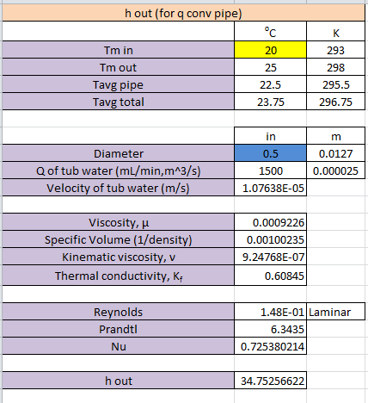
Calculating h_{out}
h_{out} is the convection coefficient of the fluid flowing over the pipe
The average temperature needed to take into account the average pipe temperature
As the flow rate of the water in the tub increases, the Reynolds number also increases
The Nusselt number is calculated using the equation for circular cylinder cross flow
h_{out} can be calculated using:
  h_{out}=(Nu*k)/D

Slide 11
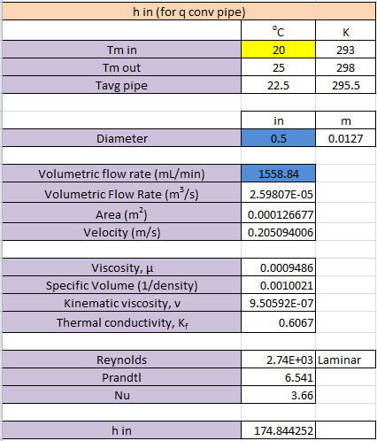
Calculating h_{in}
h_{in} is the convection coefficient of the fluid flowing inside the pipe
The average temperature used to determine fluid properties is only based on the inflow and outflow temperatures
The higher the volumetric flow rate, the higher the Reynolds number
The Nusselt number is 3.66 for all laminar flow within a pipe
Again, h_{in} can be calculated using:
  h_{in}=(Nu*k)/D

Slide 12
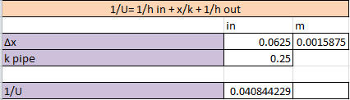
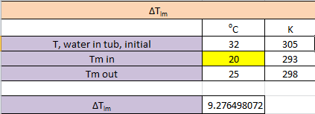
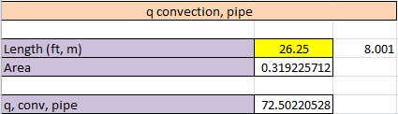
Calculating q_{conv, pipe}

Slide 13
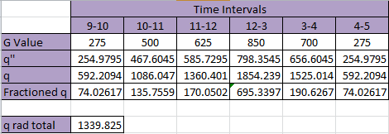
Calculating q_{rad}
Used average q_{rad} because G values changed throughout the day

Slide 14
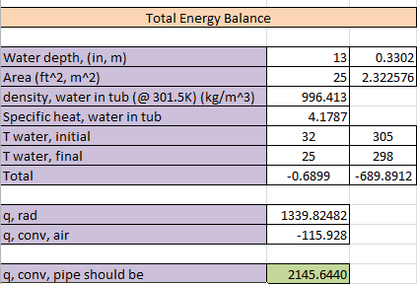
Thermal Energy Balance Calculation
Total energy, q_{rad}, and q_{conv,air} summed to find q_{conv,pipe} necessary for design
Total= mC_{p} dT/dt

Slide 15
Thermal Energy Balance
q_{in}-q_{out} = ρC_{p}V dT/dt
q_{in}= q_{rad}
q_{out}= q_{conv,air} + q_{conv,pipe}
q_{rad}= α_{s}G+σε(T_{sky}⁴-T_{s}⁴)
  Where G changes throughout the day
  ε and α_{s} from outside source
  T_{s} is surface of the water (25°C)
q_{conv,air}= hA(T_{w}-T_{air})
q_{conv,pipe}= AUΔT_{lm}

Slide 16
HOBO Data

Slide 17
Design Parameters
Diameter (in) | Inlet Temp (°C) | Pipe Length (ft)
0.5 | 0 | 445.8
1 | 0 | 350.5
2 | 0 | 278.7
3 | 0 | 244.8
0.5 | 10 | 554.8
1 | 10 | 435.7
2 | 10 | 346.2
3 | 10 | 304
0.5 | 20 | 776.7
1 | 20 | 609.5
2 | 20 | 483.9
3 | 20 | 424.7
Necessary pipe length can vary due to inlet temperature and diameter changes
Pipe lengths are unrealistic for 5’x5’ tub

Slide 18
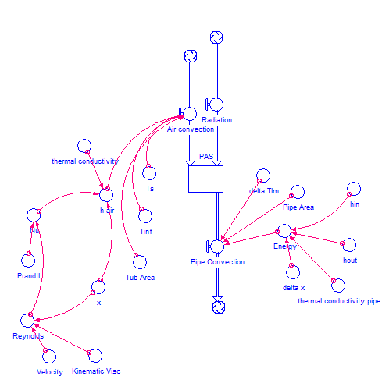
Stella Map
Pipe convection only parameter removing heat
Radiation and air convection add heat

Slide 19
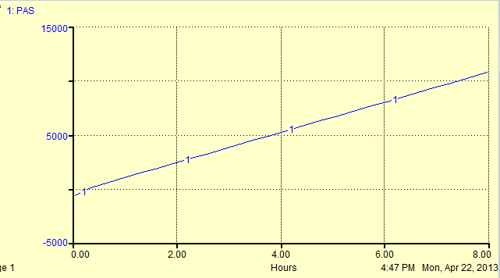
Stella Data
Time (Hours) | Total Thermal Energy (W)
0 | -689.72
0.25 | 0
0.5 | 347.54
0.75 | 695.09
1 | 1,042.63
1.25 | 1,390.18
1.5 | 1,737.72
1.75 | 2,085.27
2 | 2,432.81
2.25 | 2,780.36
2.5 | 3,127.90
2.75 | 3,475.45
3 | 3,822.99
3.25 | 4,170.54
3.5 | 4,518.08
3.75 | 4,865.62
4 | 5,213.17
4.25 | 5,560.71
4.5 | 5,908.26
4.75 | 6,255.80
5 | 6,603.35
5.25 | 6,950.89
5.5 | 7,298.44
5.75 | 7,645.98
6 | 7,993.53
6.25 | 8,341.07
6.5 | 8,688.62
6.75 | 9,036.16
7 | 9,383.70
7.25 | 9,731.25
7.5 | 10,078.79
7.75 | 10,426.34
Final | 10,773.88

Slide 20
Conclusions
Necessary pipe dimensions unrealistic for our setup
If implemented in summertime, HOBO data could be more conclusive
  Higher air and water temperatures
  Water temperature more constant over the day
Water difficult to cool due to high specific heat
  Could use pipe with higher thermal conductivity (copper, aluminum)
Alternative designs:
  Larger diameter pipe
  Colder fluid through pipe (frion)
  Pipe inside a pipe (double-pipe heat exchanger)

Slide 21
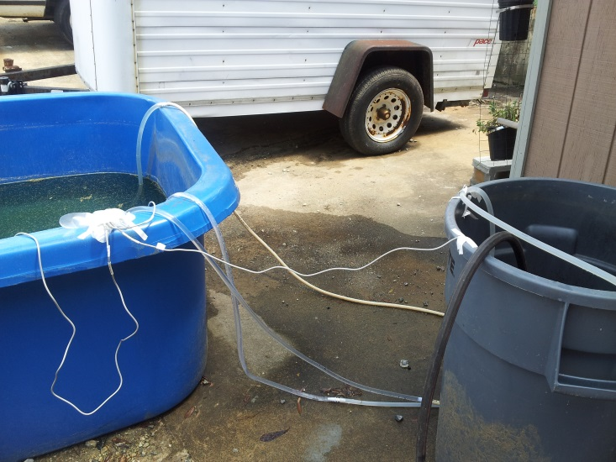
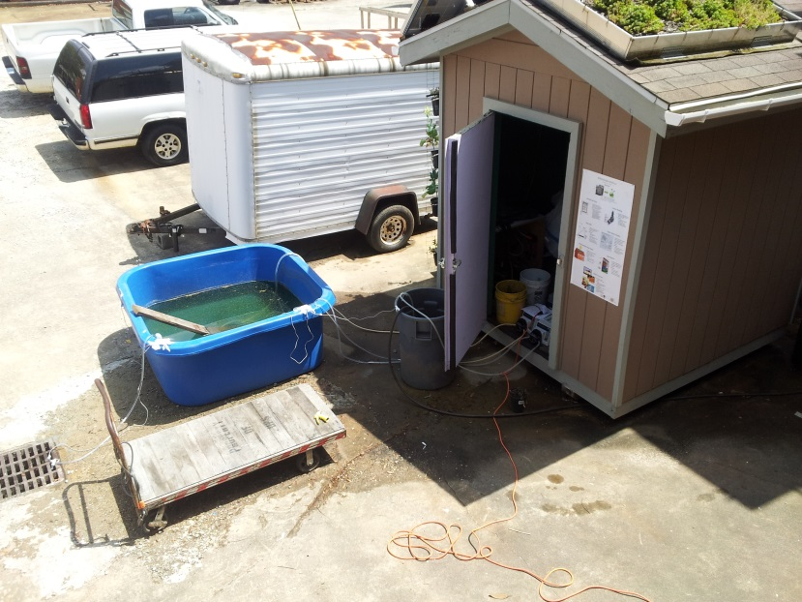
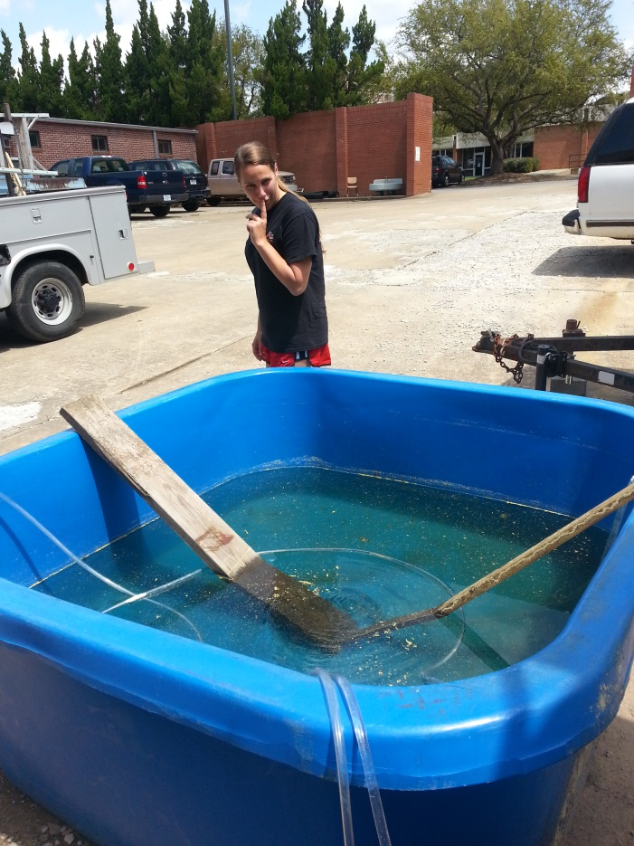
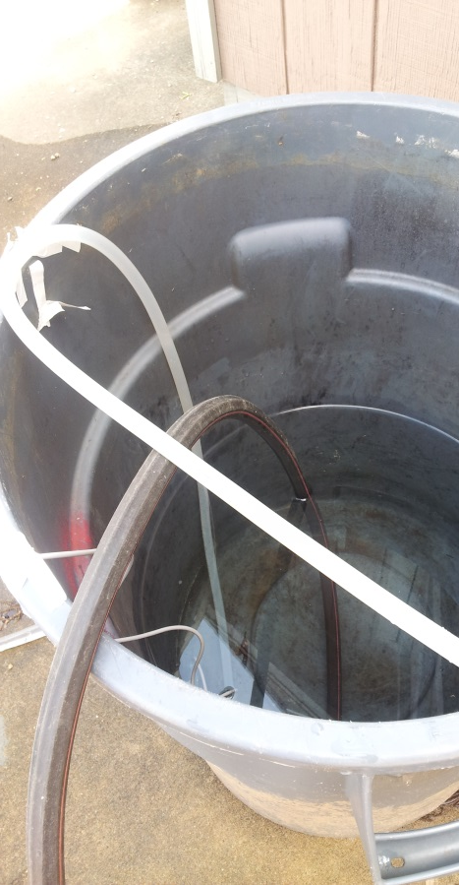
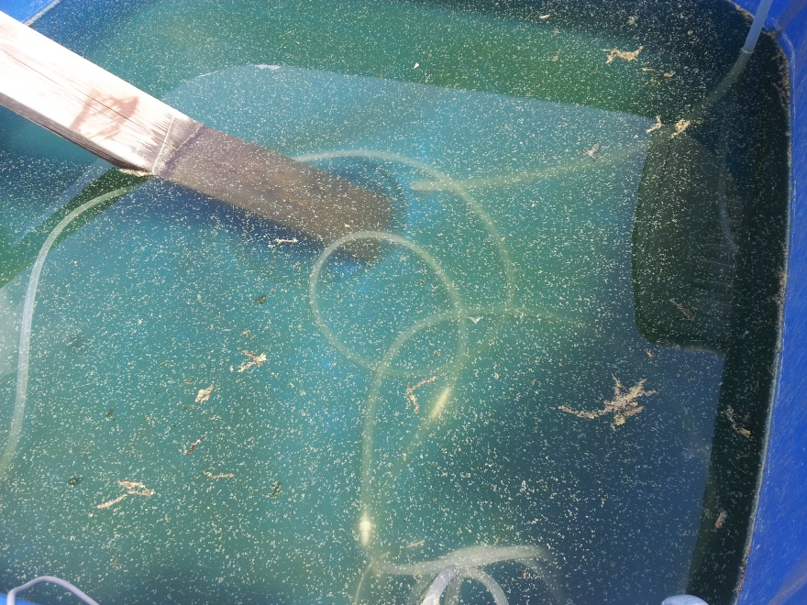
Project
Fun!

Slide 22
References
"Absorptivity and Emissivity of a Solar Selective Surface." N.p., n.d. Web. 15 Apr. 2013. <http://www.cambridge.org/us/engineering/author/nellisandklein/downloads/examples/EXAMPLE_10.4-1.pdf>.
Dellinger, Dan. "Wind- Average Wind Speed- (MPH)." Wind- Average Wind Speed- (MPH). National Climatic Data Center- NOAA, 20 Aug. 2008. Web. 23 Apr. 2013. <http://www.ncdc.noaa.gov/oa/climate/online/ccd/avgwind.html>.
Drapcho, Caye M. “BE 412- Heat and Mass Transport Lecure Notes.” Clemson, SC 2013.

Slide 23
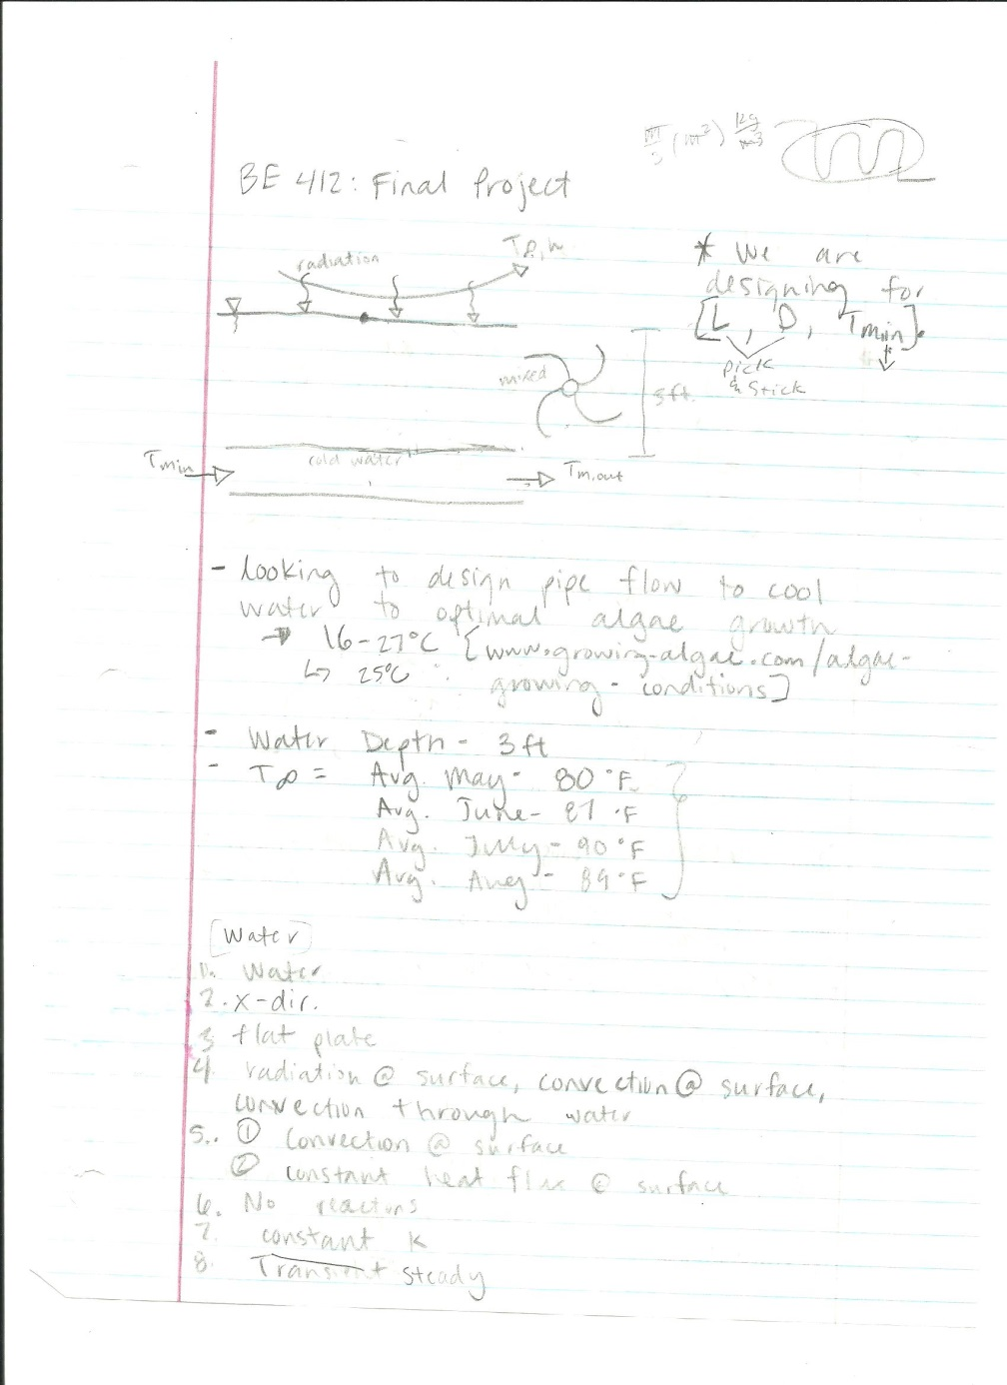
Appendix- Hand Calculations

Slide 24
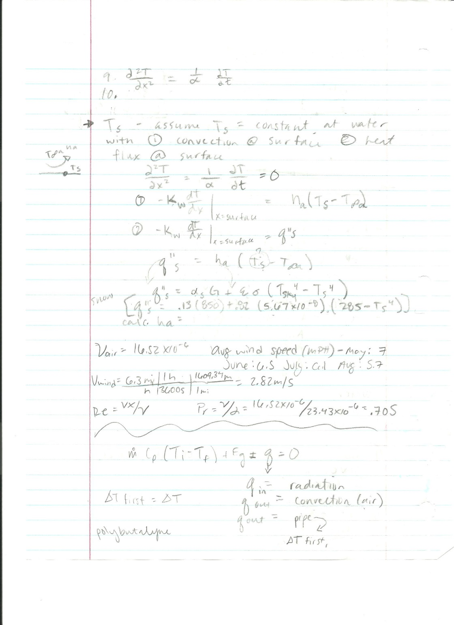

Slide 25
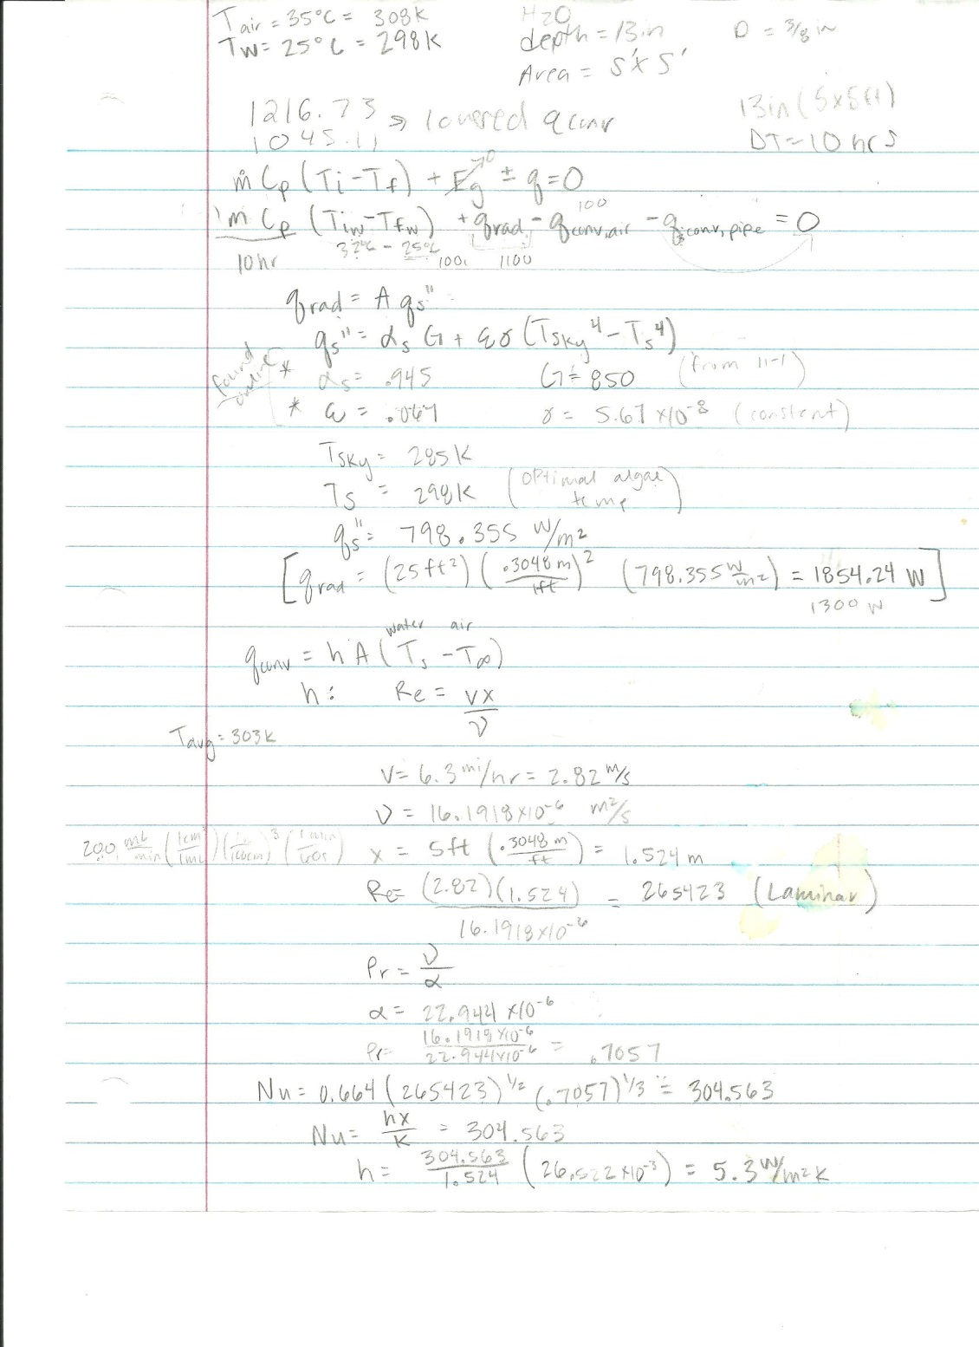

Slide 26
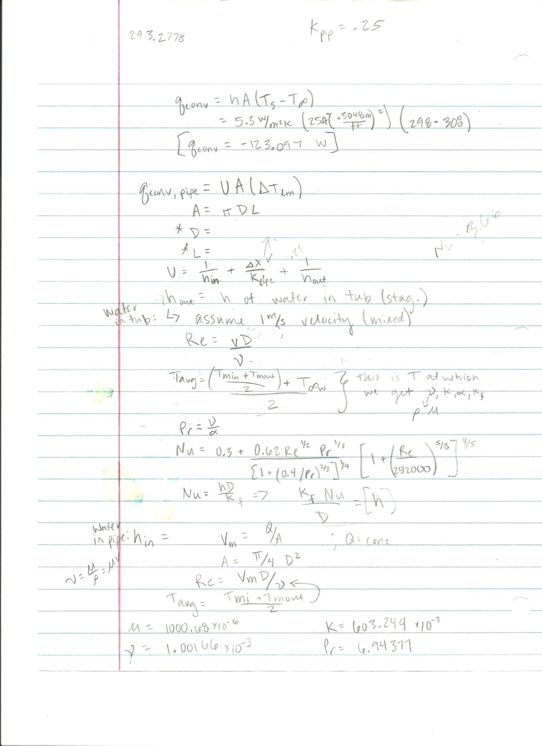

Slide 27
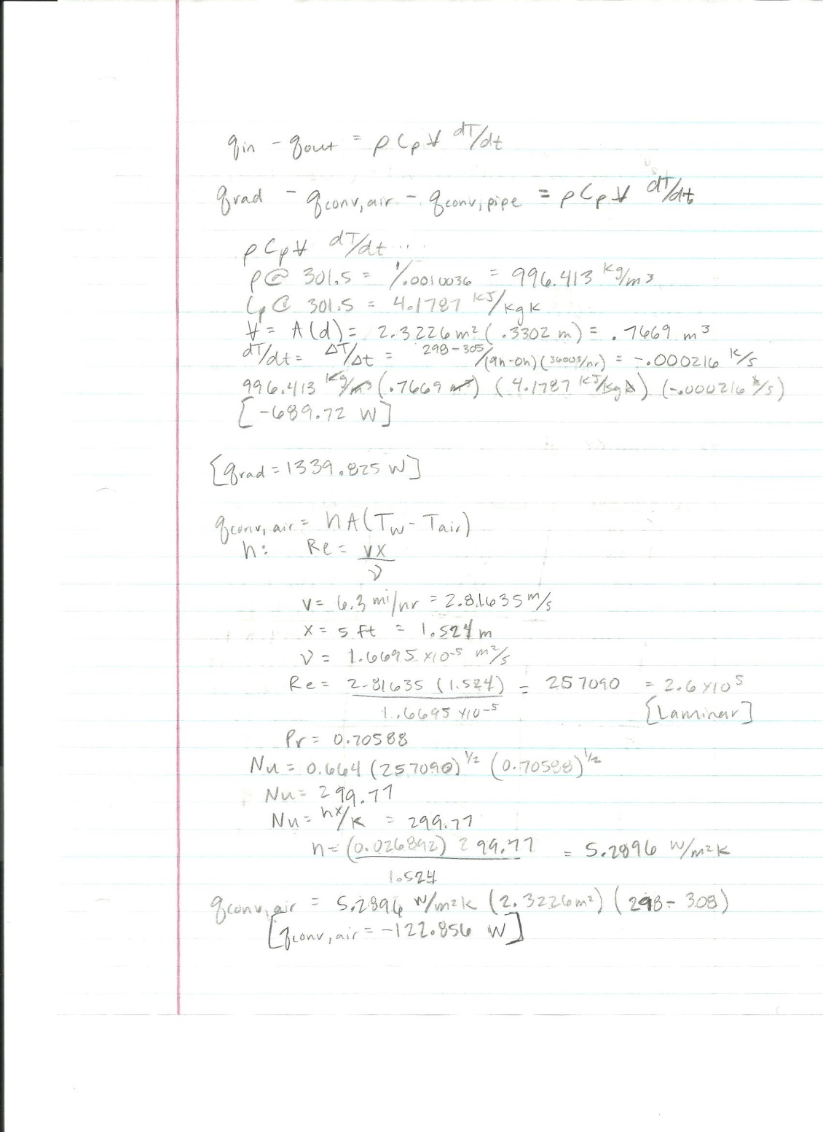

Slide 28
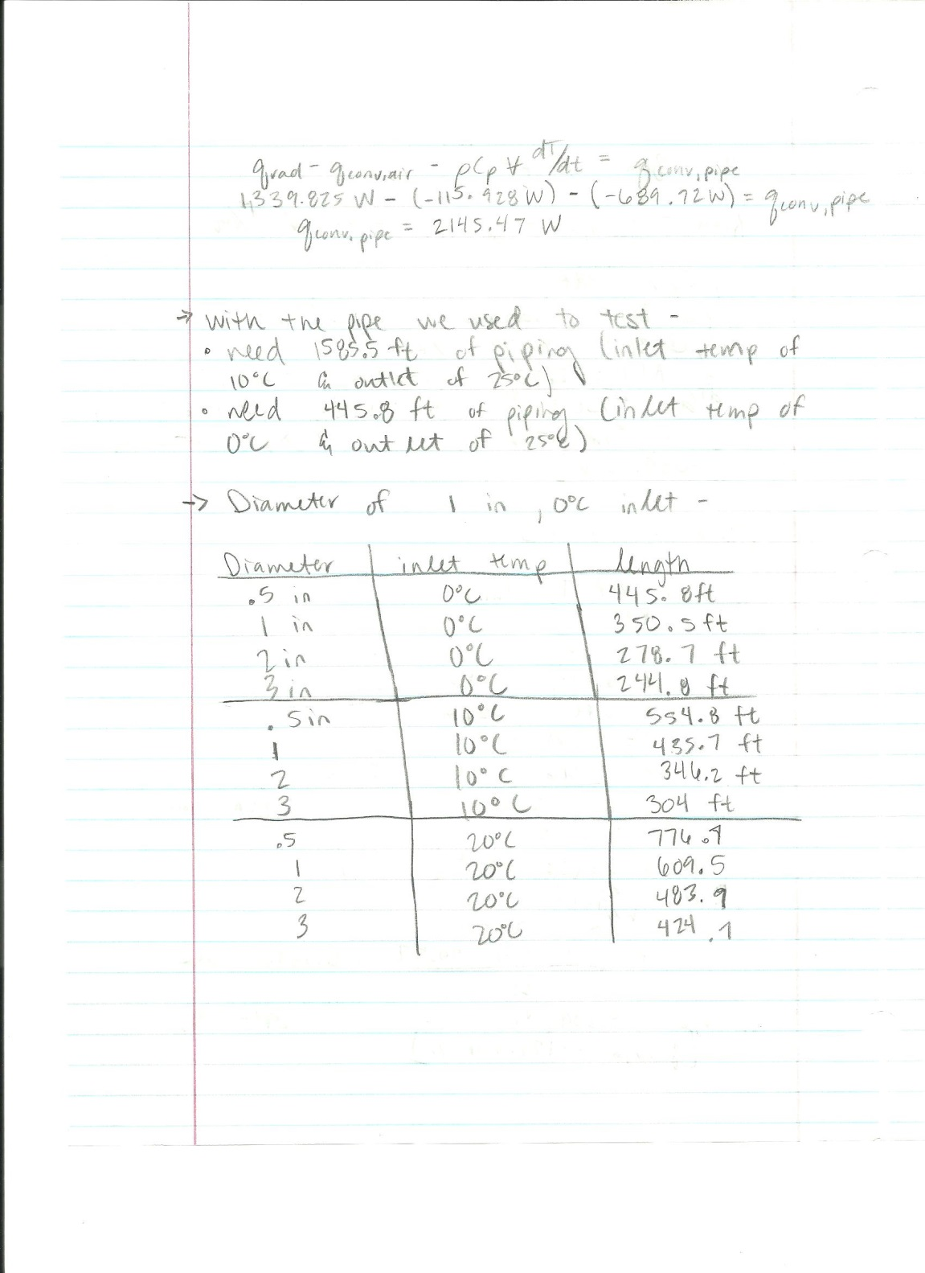

Slide 29
